Slide 1
WIRELESS EMBEDDED SYSTEM Cloud Computing and Storage
Doan Duy, Ph. D.
Email: duyd@uit.edu.vn

Slide 2
Objectives
Getting an overview of cloud computing
Getting known of basic model and service of cloud computing
Understanding model of cloud storage

Slide 3
Content
Introduction to cloud computing
Virtualization in cloud computing
Cloud Storage: service and require

Slide 4
Introduction to Cloud Computing

Slide 5
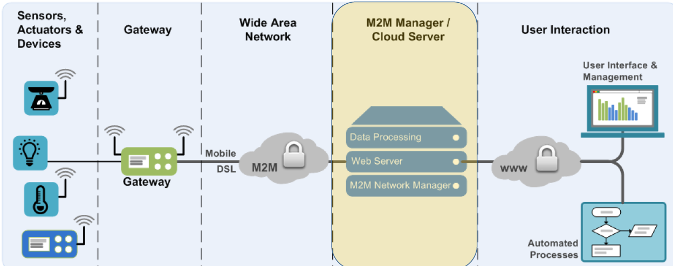
IoT Infrastructure

Slide 6
Watching Video…
Characteristic of Cloud Computing
Model of Cloud Computing

Slide 7
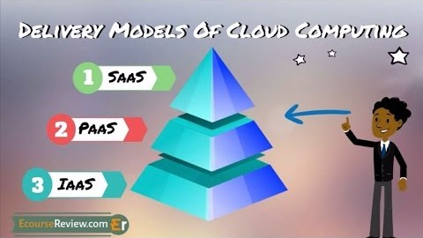
Watching Video…

Slide 8
Why Cloud Computing and Storage?
Organizations can sift through their information that devices send and make sense of it in a timely manner.
They need strong networks that must access data from any location, at any time.
The ability to process data quickly and easily view and share it in the right context.
Context is generated based on large data over time and from many sensors.
Preventive maintenance based on a mean-time-to-failure analysis.
IoT literally lets you listen to the hum of the turbines and know by frequency whether they are out of spec and need to be fixed now.

Slide 9
Data and Big Data
Creating data that helps to make the decisions.
Just because you have lots of data doesn’t make you efficient.
You have to be able to handle the data and use it to do things that promotes the organization.
Data analytics
Applying machine learning to analyze the data and make use of it

Slide 11
Cloud Computing/Storage and IoT
Cloud computing and IoT are tightly coupled
The widespread connection of device has lead to the production of huge amounts of data.
Stored
Processed
Accessed
Cloud computing is a paradigm for big data storage and analytics.

Slide 12
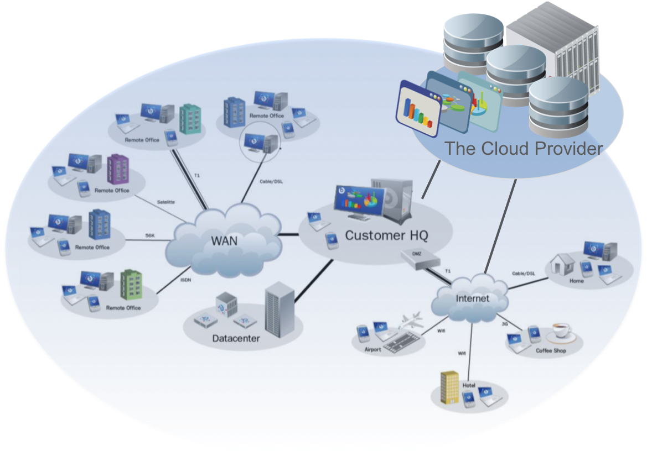
Cloud Computing and Storage
A collection of integrated and networked hardware, software and Internet infrastructure.
Using the Internet for communication and transport provides hardware, software and networking services to clients
Hide the complexity and details of the underlying infrastructure by providing simple interface

Slide 13
Cloud Computing: Properties
Shared pool of configurable computing resources
On-demand network access
Maintained by the Service Provider
Services:
On Demand Self-Service
Rapid Elasticity -Provide scalable services
Broad Network Access
Resource Pooling-Grouping of resources
Measured Service

Slide 14
Common Requires
Massive Scale
Resilient Computing
Geographic Distribution
Virtualization
Service Orientation
Application and Software
Appropriate Security

Slide 15
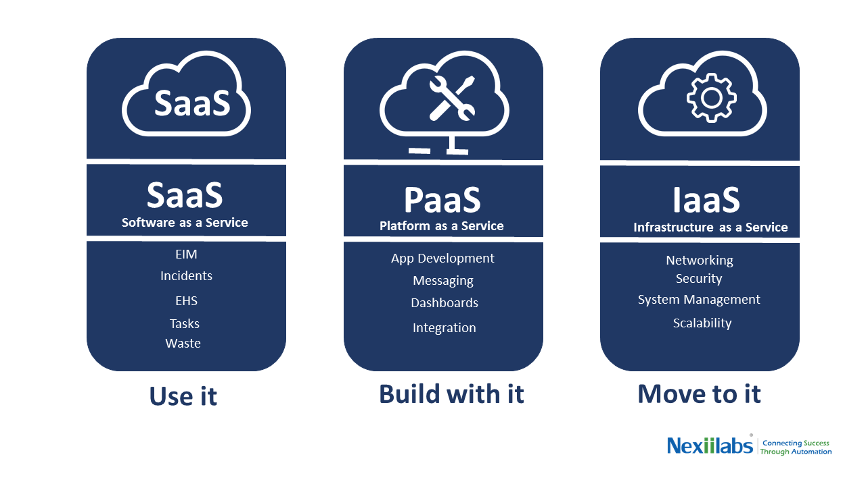
Cloud Service Model

Slide 16
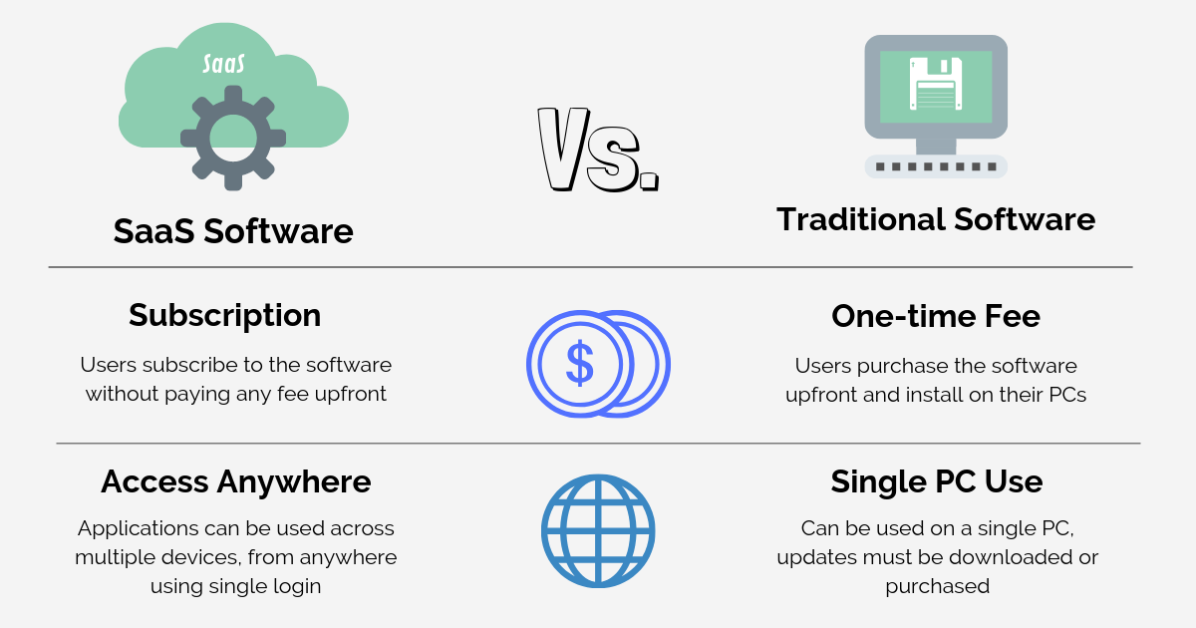
SaaS: Software as a Service

Slide 17
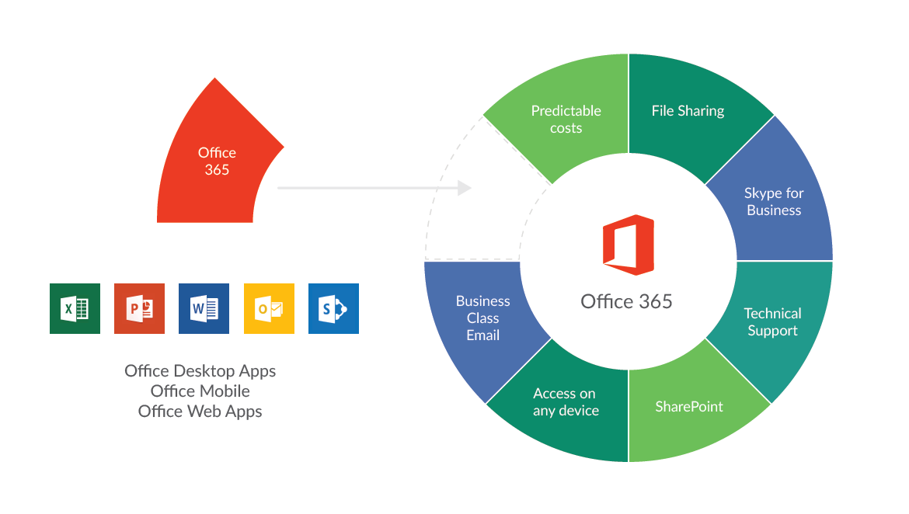
SaaS: Example of Microsoft Office 365

Slide 18
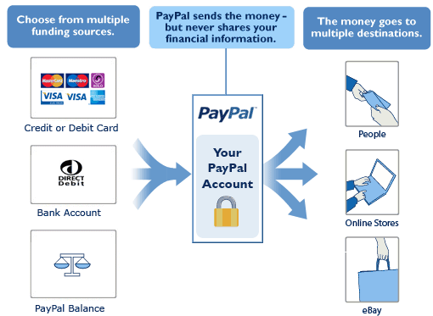
PaaS: Example of Paypal Platform

Slide 19
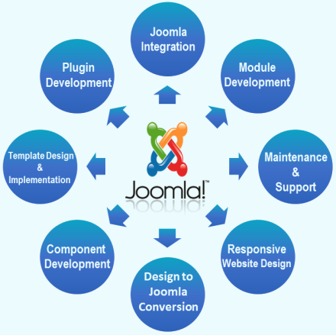
PaaS: Example of Joomla Platform

Slide 20
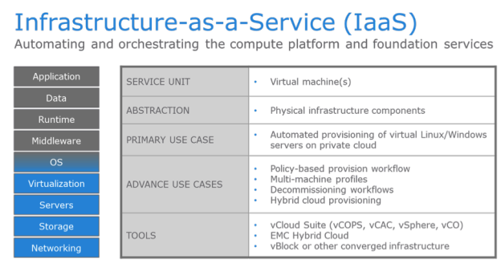
IaaS: Infrastructure as a Service

Slide 21
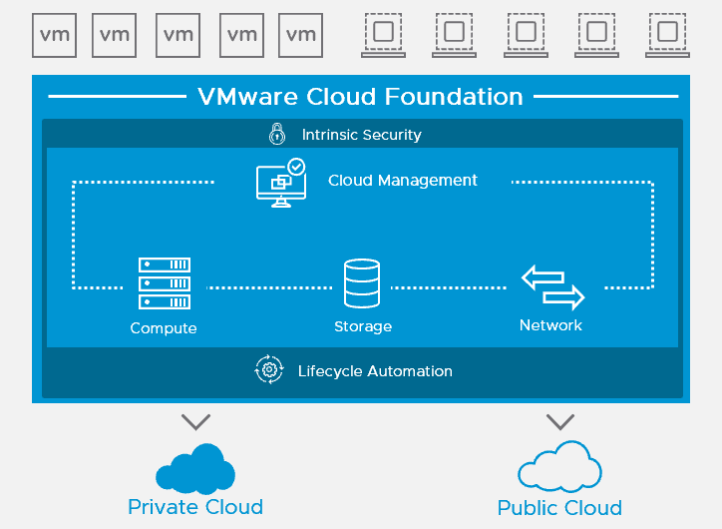
IaaS: VMWare

Slide 22
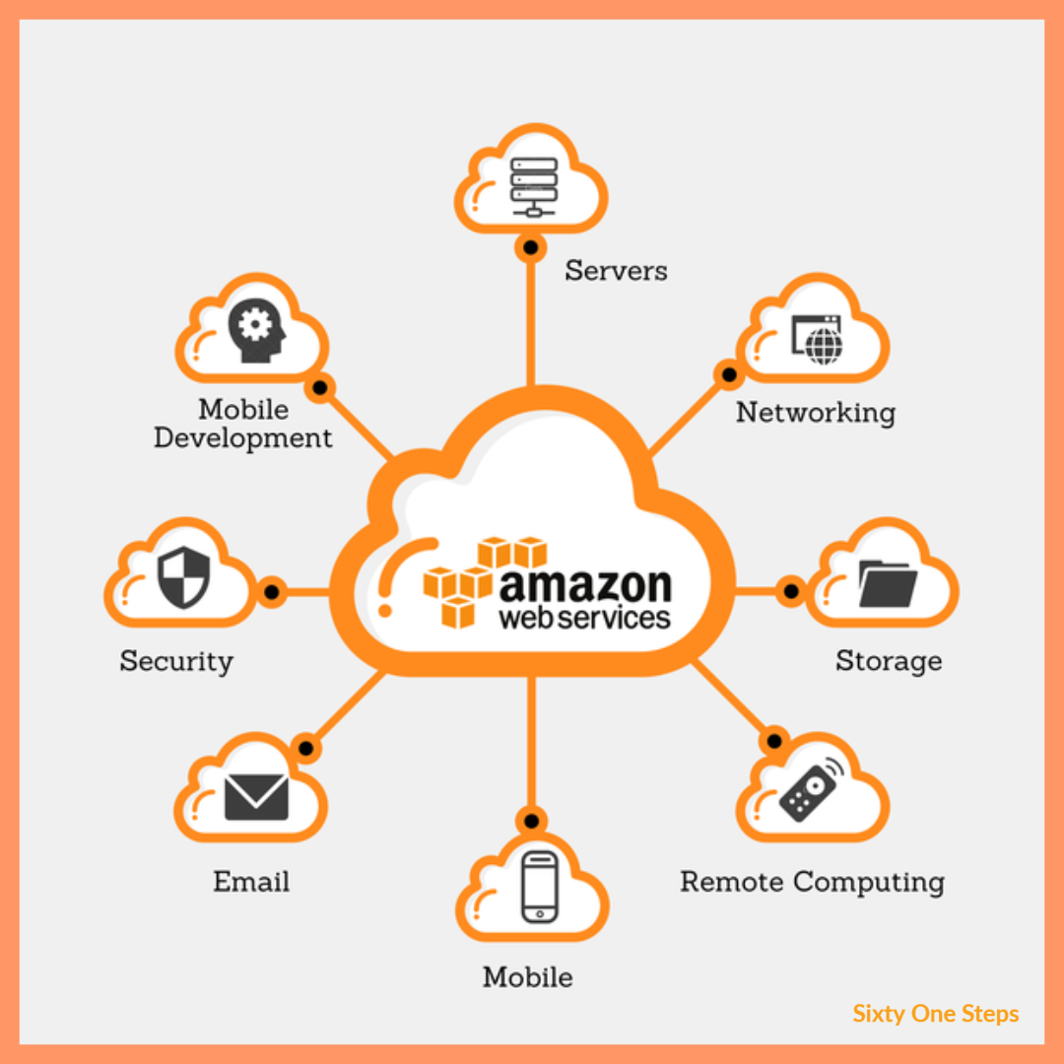
IaaS: Amazon Web Service

Slide 23
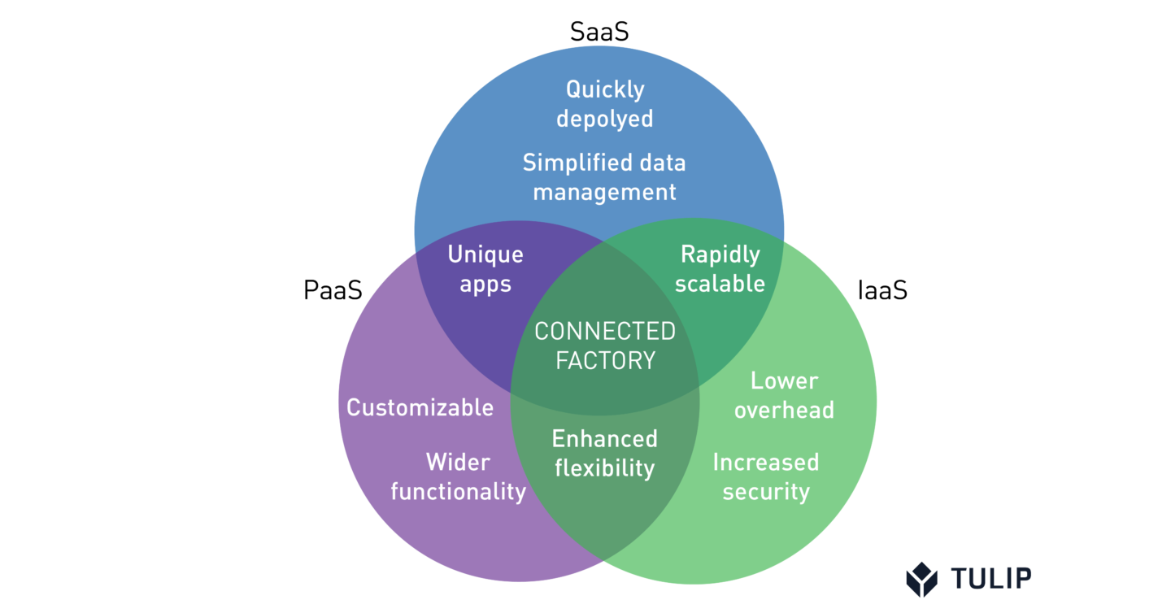

SaaS, PaaS and IaaS

Slide 24
Virtualization
in Cloud Computing

Slide 25
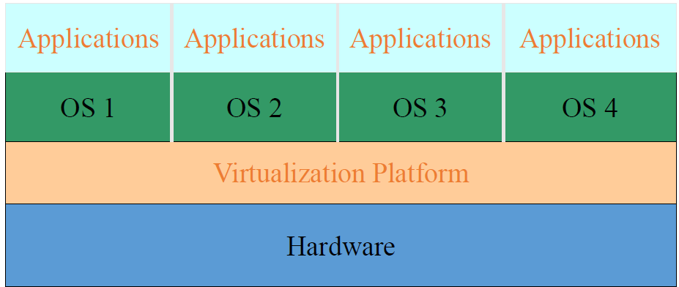
Virtualization
Create a platform that emulates a hardware platform and allow multiple instances of an OS to use that platform, as though they have full and exclusive access to the underlying hardware.

Slide 26
Virtualization – Why?
Server Consolidation
Often many servers support 1 major application
Strong isolation between VMs
Virtualization saves on hardware & energy
Disaster Recovery
High Availability
Testing and Deployment

Slide 27
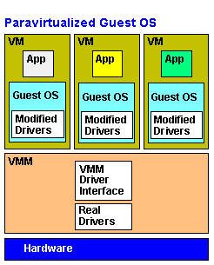
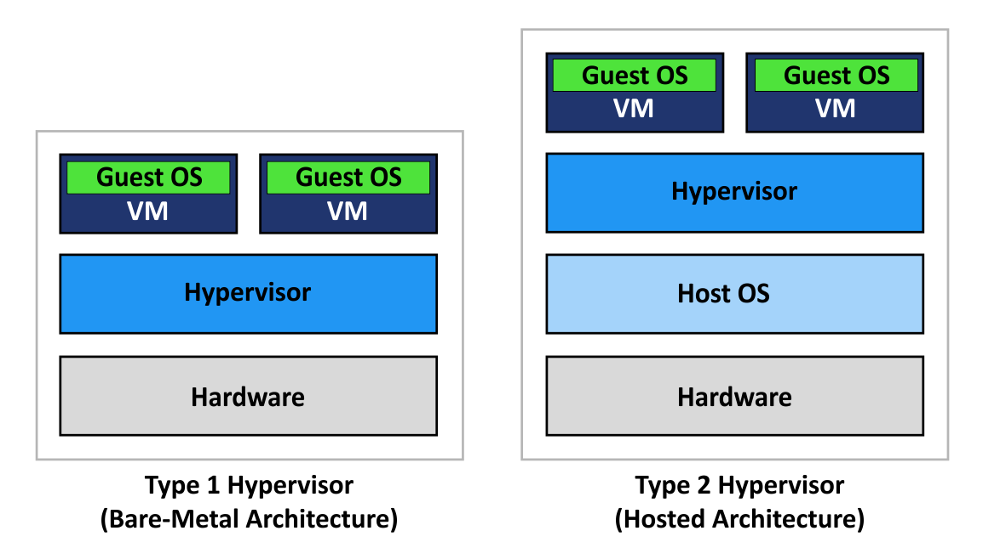
Implementation of Virtualization
Type 1 Hypervisor
Type 2 Hypervisor
Paravirtualization

Slide 28
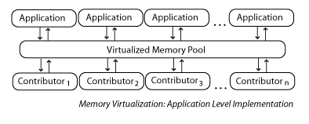
Memory Virtualization

Slide 29
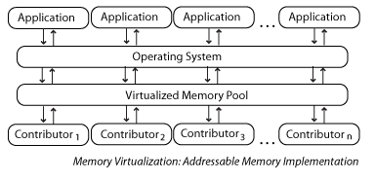
Memory Virtualization

Slide 30
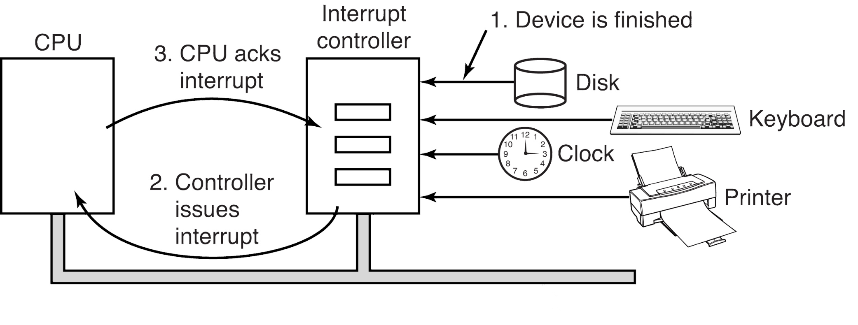
I/O Virtualization

Slide 31
Cloud Storage

Slide 32
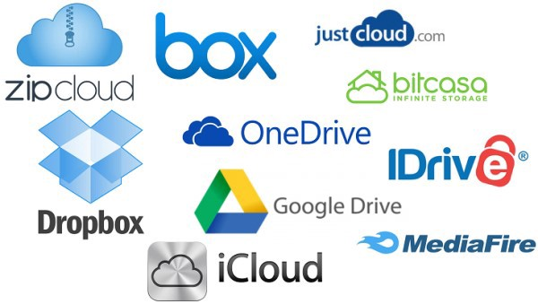
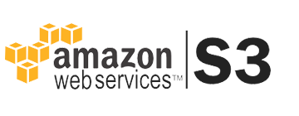
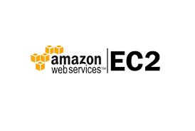
Cloud Storage

Slide 33
Cloud Storage: Advantages
Lower computer costs:
No need for high-powered and high-priced computer to run cloud computing's web-based applications.
Applications run on the cloud and the user’s desktop computer does not need high processing power or large disk.
Improve performance:
Large computing load will be execute on the cloud and leave more space and computation power for you local applications.
Reduced software costs:
Instead of purchasing expensive software applications, you can get most of what you need for free or almost free.

Slide 34
Cloud Storage: Advantages
Instant software updates
Improved document format compatibility.
There are potentially no format incompatibilities when everyone is sharing documents and applications in the cloudReducedsoftware costs.
Unlimited storage capacity
Cloud computing offers virtually limitless storage.
Increased data reliability
No need for backups in case of failure.
Easier group collaboration.
Device independence.

Slide 35
Cloud Storage: Challenge
Dependence on others who are big and will become bigger.
Back to the mainframe computing era
Security could prove to be a big issue:
How safe out-sourced data
How own this data
Policy and access:
The data is stored in various countries which adhere to different polices?
Who control these accounts ?
Access files your data is require some regulation ?

Slide 36
Cloud Storage: Limitation
Requires a constant Internet connection.
To work well, speed connections need to be high
Features might be limited
Security issues

Slide 37

Q&A

Slide 38
Memory Virtualization
OS tracks mapping of virtual memory pages to physical memory pages.
Builds page tables, then update paging register (trap).
Allow hypervisor to manage page mapping, and use shadow page tables for the VMs

Slide 39
Memory Virtualization
VMM creates and manages page tables that map virtual pages directly to machine pages
These tables are loaded into the MMU on a context switch
VMM page tables are the shadow page tables
VMM needs to keep its Virtual-Map tables consistent with changes made by OS to its Virtual-Physical tables
VMM maps OS page tables as read only
When OS writes to page tables, trap to VMM
VMM applies write to shadow table and OS table.

